Slide 1
Ulysses HISCALE
Data Production and Archiving
Status Report
Report to Final Investigation
Team Meeting
Belmont Conference Center
September 30, 2009
Thomas P. Armstrong
Fundamental Technologies, LLC

Slide 2
Outline
Production Status
Archiving Status
Samples of Archive Products
Instrument and Software Performance
Calibration Issues
Supporting Detail

Slide 3
1. Production Status
Processing of all HISCALE products is complete for the period from turn-on through 2008 (6624 days for which 6608 days are available 99.76% throughput—details on next slide)
Processing for 2009 awaits the availability of MAG data for merging

Slide 4
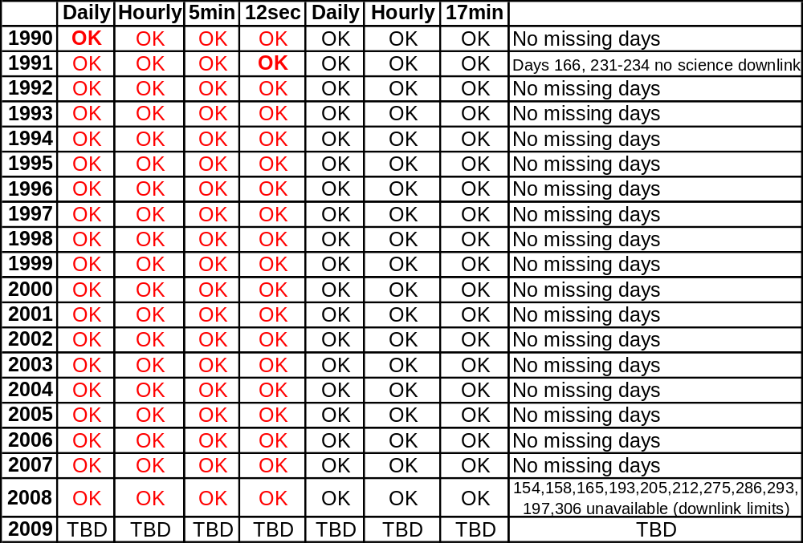
Production Details

Slide 5
1. Production Status (continued)
A full compilation in zipped (.csv) of all HISCALE products at all cadences for the 1990-2008 period has been copied to USB external disc drives for distribution at this meeting (25.6 Gbyte in 75,469 files in 88 folders). 2009 will be posted at an ftecs url for download later.
ACE/EPAM data for 1997 through June, 2009 in similar format, partially complete, has also been copied to these USB discs for distribution here (12.7 GBytes, 39,366 files, 57 folders)
Item by item descriptions of each item in each file type are provided in the extended version of this presentation and in the file “hiscale_vho_vepo_summaries”

Slide 6
1. Production Status (continued)
There are 9 types of count rate files—all channels sectored, all channels spin averaged including ephemeris and orientation, magnetic field in RTN and HEL and pitch angles for all sectors
There are 12 types of binned pulse height data (mfsa-derived) expressed as fluxes of protons (25 channels), Z>1 ions (25 channels), and electrons (12 channels) in the solar wind frame.
There is a file all energy calibrated CD coincident pulse heights accompanied rate channel tags and a second file of synchronously accumulated rates for all of the CD generated channels.

Slide 7
2. Archiving Status
TPA and JDP developed products, product descriptions, granules and granule descriptions expressed in SPASE-compatible XML all of which have been made available to the Virtual Heliospheric Observatory (http://vho.nasa.gov/) via the Virtual Energetic Particle Observatory (http://vepo.gsfc.nasa.gov/)
Fundamental Technologies has proposed to NASA HQ for continuing support as a resident archive to serve out the data from http://hiscale.ftecs.com/index.html and to create a mirror site at JHUAPL (Jon Vandegriff,co-I)
Fundamental Technologies is in process of acquiring a dedicated fiber optic internet link which will provide about 10x the present bandwidth.

Slide 8
3. Samples of Archive Products
Rate Group 65—all channels spin averaged
Print Group 80—spin averaged fluxes of protons in the solar wind frame
PHA Events (see Appendix C1)

Slide 9
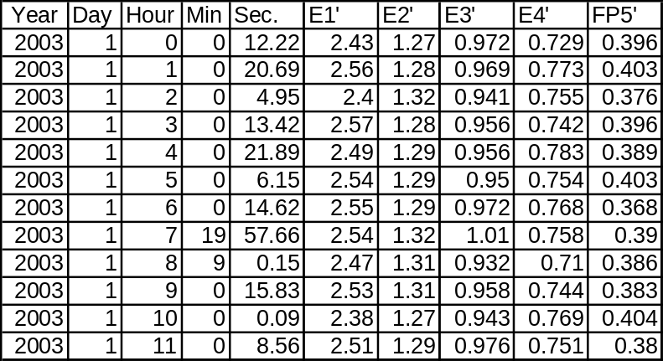
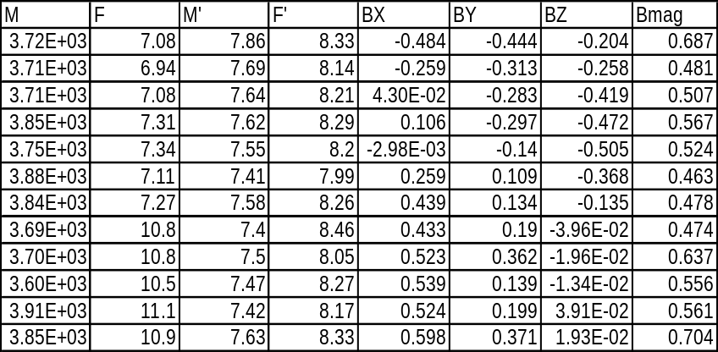
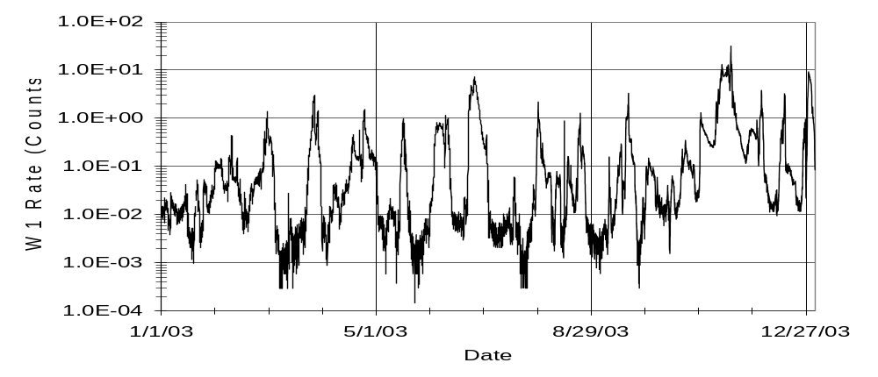
Rate Group 65
Columns omitted

Slide 10
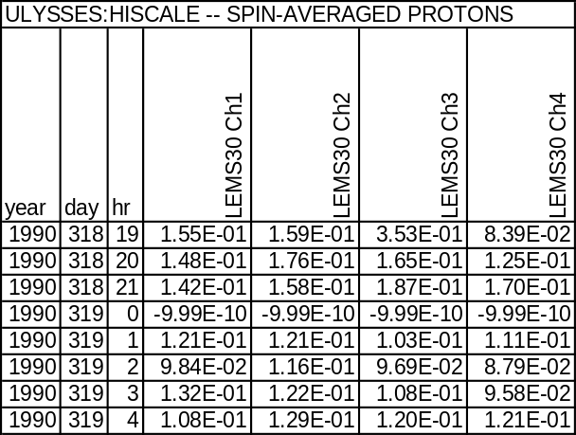
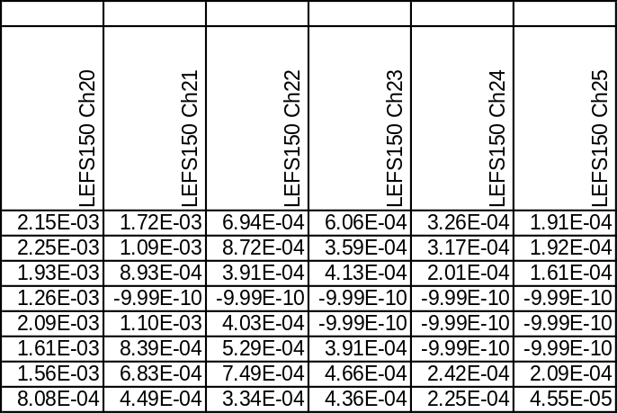
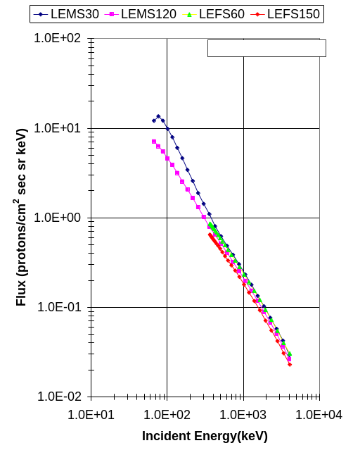
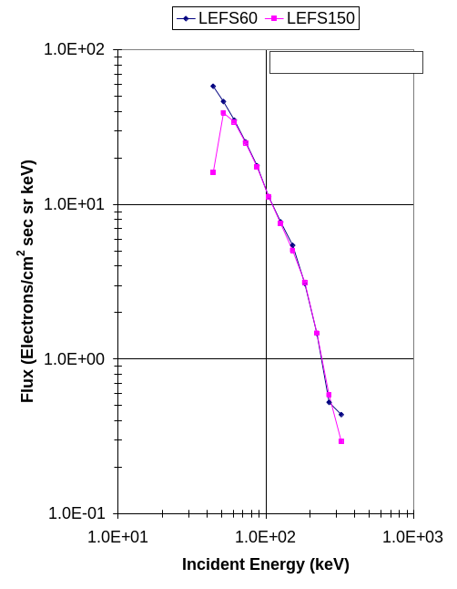
Print Groups 80 & 81
Columns omitted

Slide 11
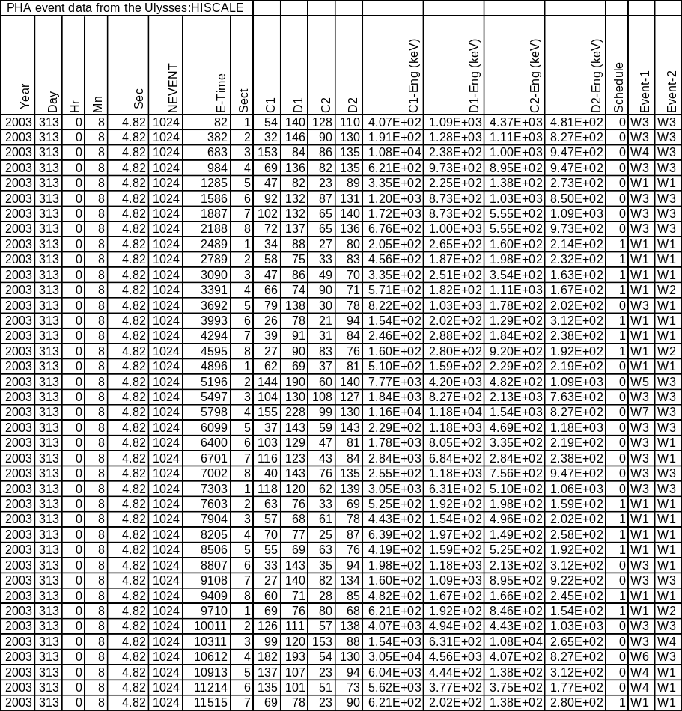
PHA Events (first few lines of event data file for 2003 day 313)

Slide 12
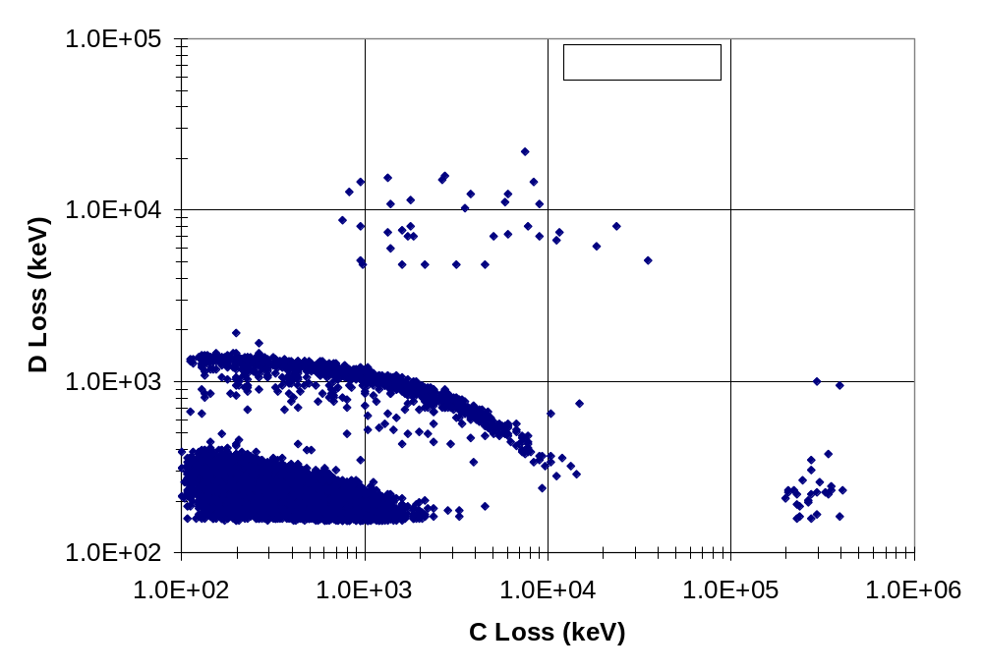

Slide 13
4. Instrument and Software Performance
The most conspicuous in-flight instrument difficulty is the sensitivity of the LEMS 30 sensor to the sun. A large but variable faction of the time the lowest 2 or 3 energy channels respond to the sun in sectors 1 and 4. “Spin” averages account for this by omitting sectors 1 and 4 for all averages.
Out-of-passband or “background” responses are important—especially in the single parameter channels. Gamma rays from the radioisotope thermoelectric generators and galactic cosmic rays penetrating the passive shielding. Backgrounds for every channel have been estimated and are tabulated in vhp\vepo\ulysses_hiscale\backgrounds.
Uncorrected data transmission errors are evident in the highest time resolution data. Use of this data requires visual inspection.
Averages of the “as received” data have been computed and posted but these should also be visually inspected before use.

Slide 14
Instrument and Software Performance (cont’d)
For the convenience of archive data users, “filtered” time averages have been posted alongside the “as is” files. Median filtering was used where the median and interquartile (IQ) values was computed and data values exceeding the median +3*IQ or less than median-3*IQ were excluded from the averages.
While the calibrated pha events are compiled and presented in the archive, any prospective user of this data is strongly urged to become familiar with the experience with this data that has been reported by Lanzerotti, Maclennan (see the HISCALE bibliography) and others before using it in publication.

Slide 15
5. Calibration Issues
The design and execution of the various components of the HISCALE instrument are extensively described in “The HISCALE Data Analysis Handbook” which may be examined at http://hiscale.ftecs.com/index.html.
The instrument and investigation are described in Lanzerotti, L. J., R. E. Gold, K. A. Anderson, T. P. Armstrong, R. P. Lin, S. M. Krimigis, M. Pick, E. C. Roelof, E. T. Sarris, G. M. Simnett, and W. E. Frain, Heliosphere Instrument for Spectral, Composition and Anisotropy at Low Energies, Astron. Astrophys. Suppl., 92, 349, 1992.
Further computer calculation, numerical modeling, and in-flight calibrations support the passbands and geometrical factors used to calculate fluxes quoted in the archive. Searchable PDF files of detailed write-ups have been posted at \\ftecs\data\VHO\VEPO\ulysses_hiscale\documents and manuscripts
A inconsistency in the comparison of STEREO values for electron fluxes compared to ACE/EPAM led us to revisit our comparison of EPAM with IMP8 CPME. Patterson will report on the results of this here.

Slide 16
6. Supporting details
Install reading glasses and enjoy—you might consider pausing here to get a glass of your favorite beverage.

Slide 17
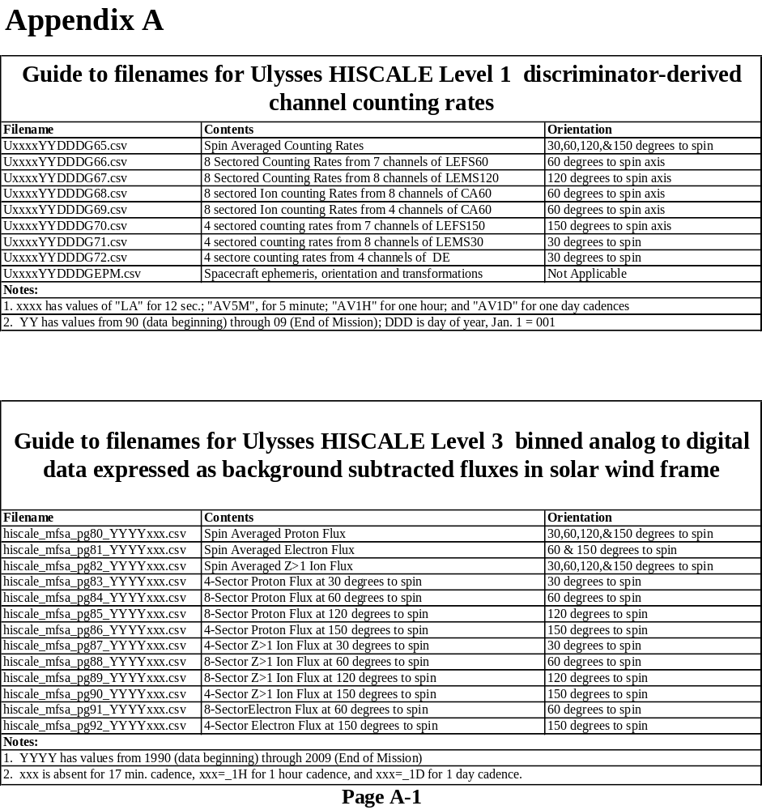

Slide 18
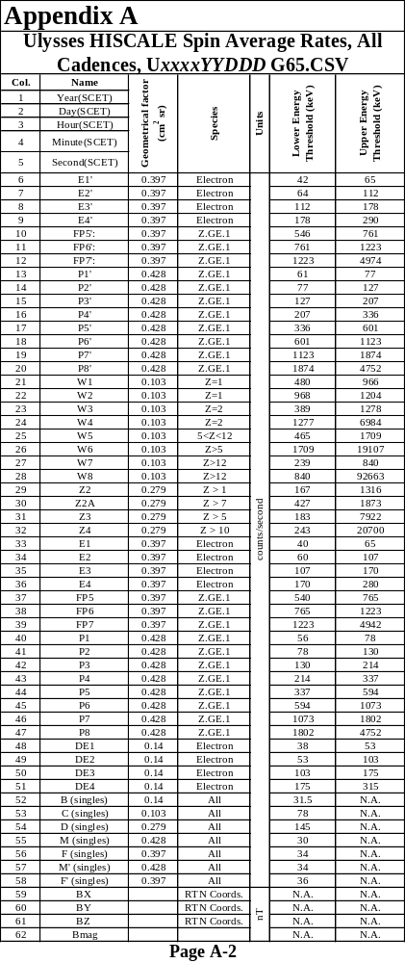

Slide 19
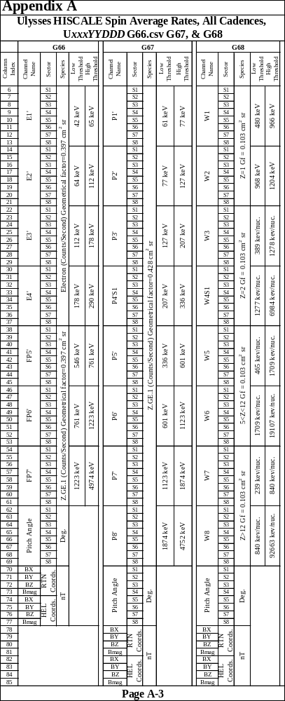

Slide 20
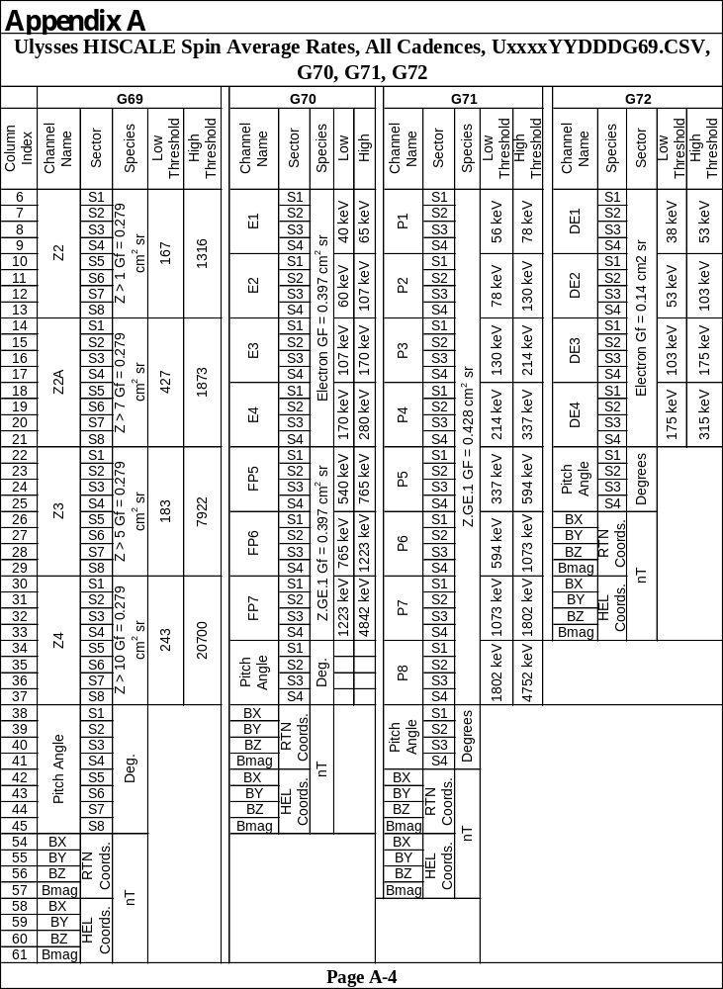

Slide 21
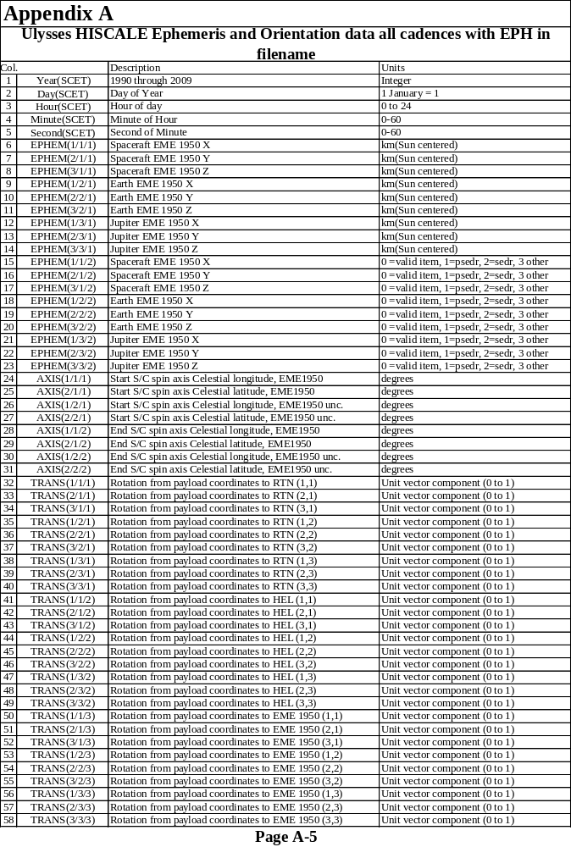

Slide 22
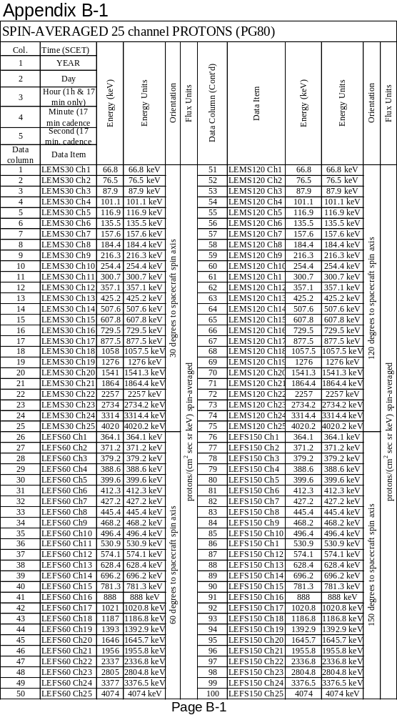

Slide 23
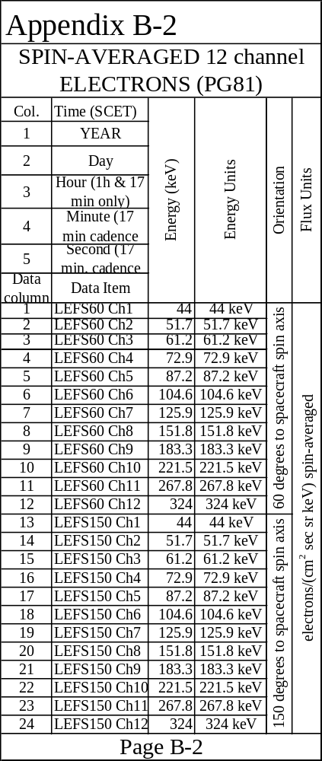

Slide 24
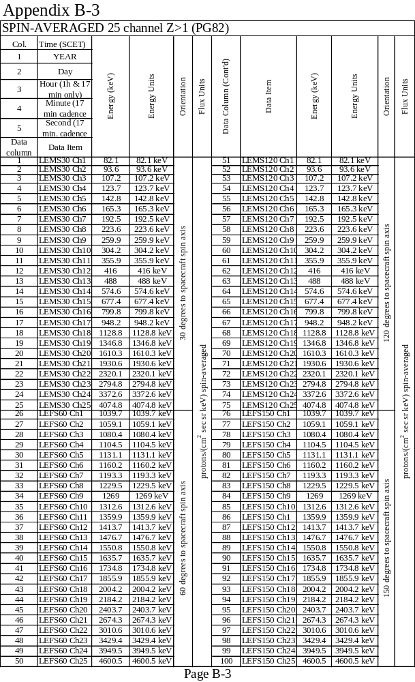

Slide 25
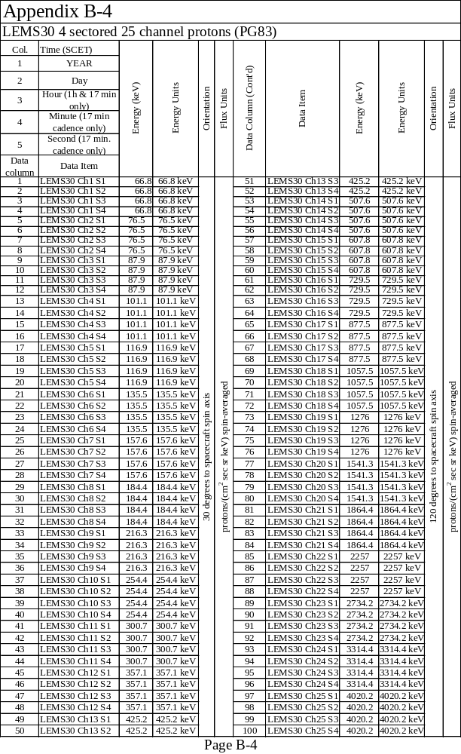

Slide 26
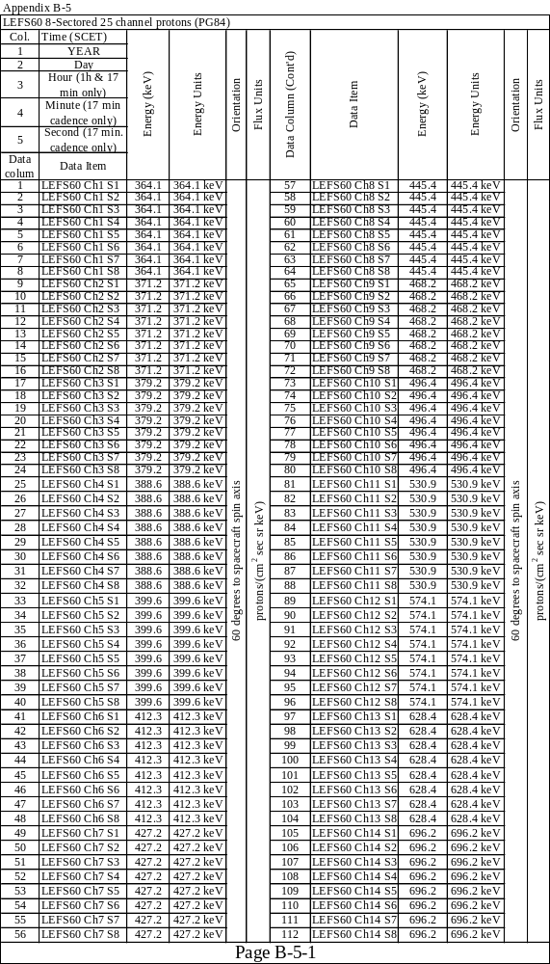

Slide 27
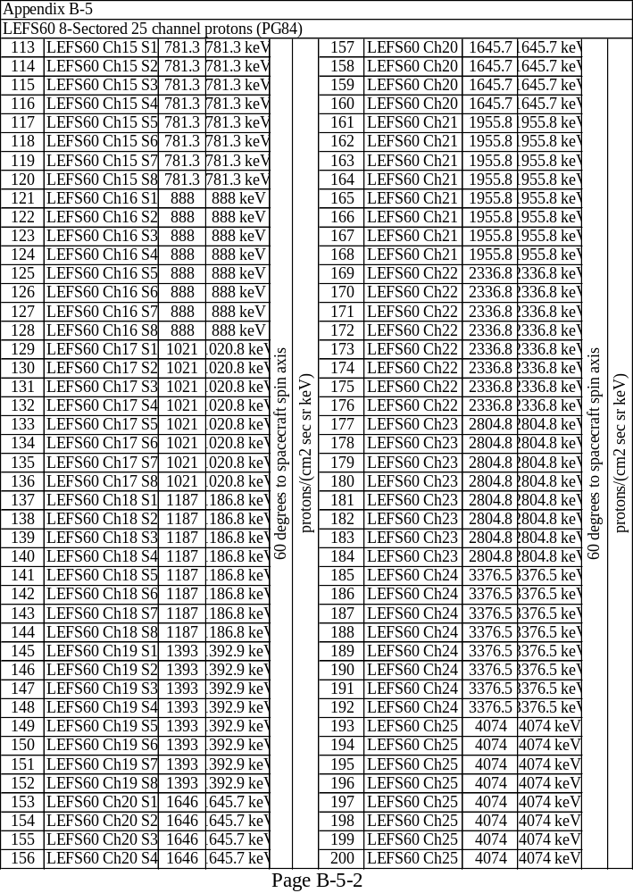

Slide 28
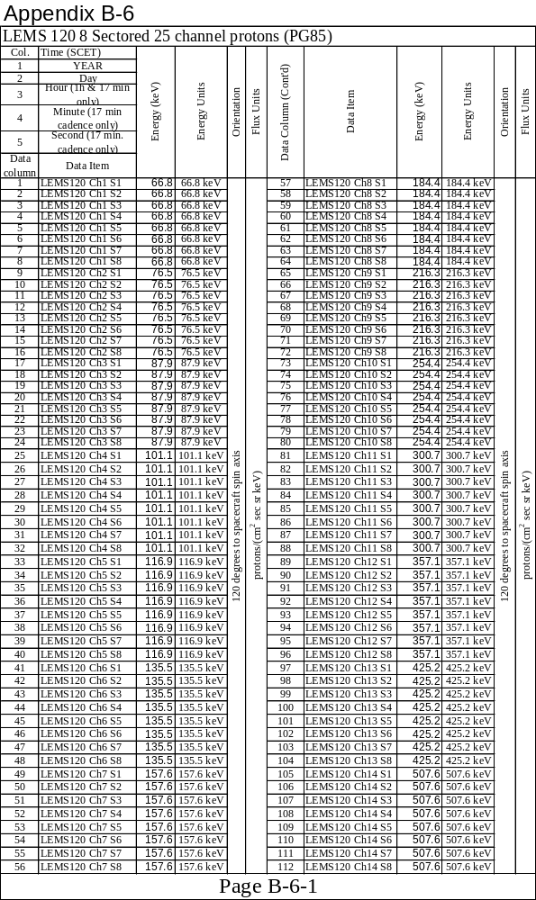

Slide 29
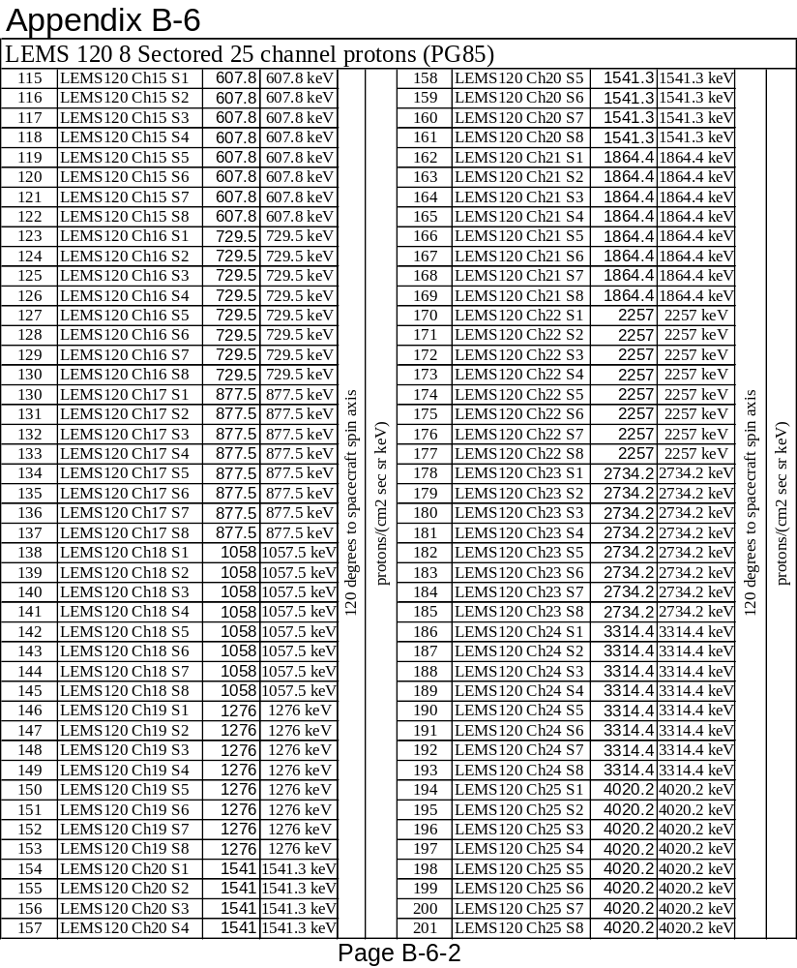

Slide 30
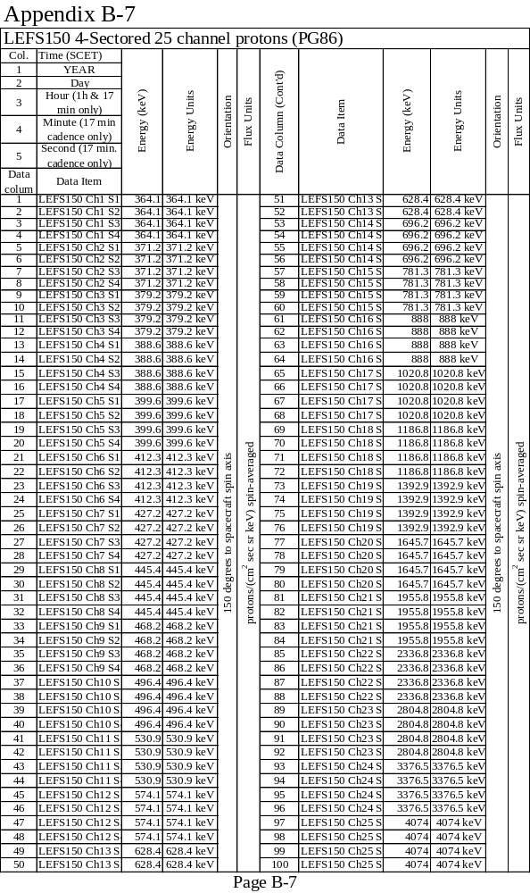

Slide 31
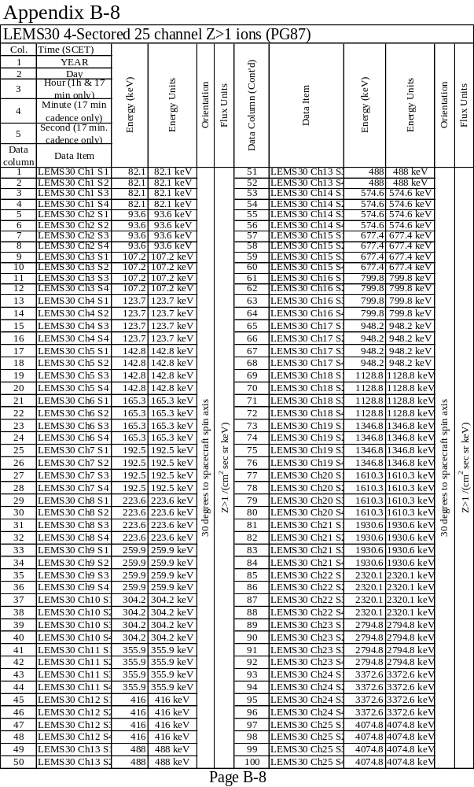

Slide 32
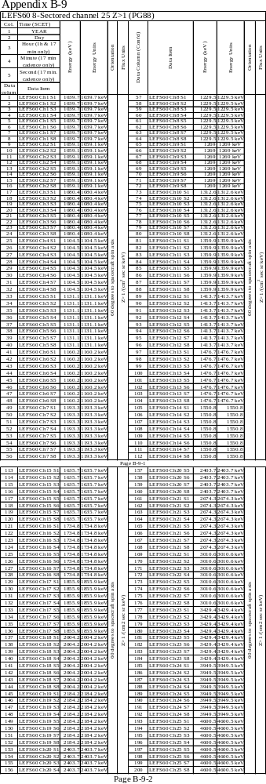

Slide 33
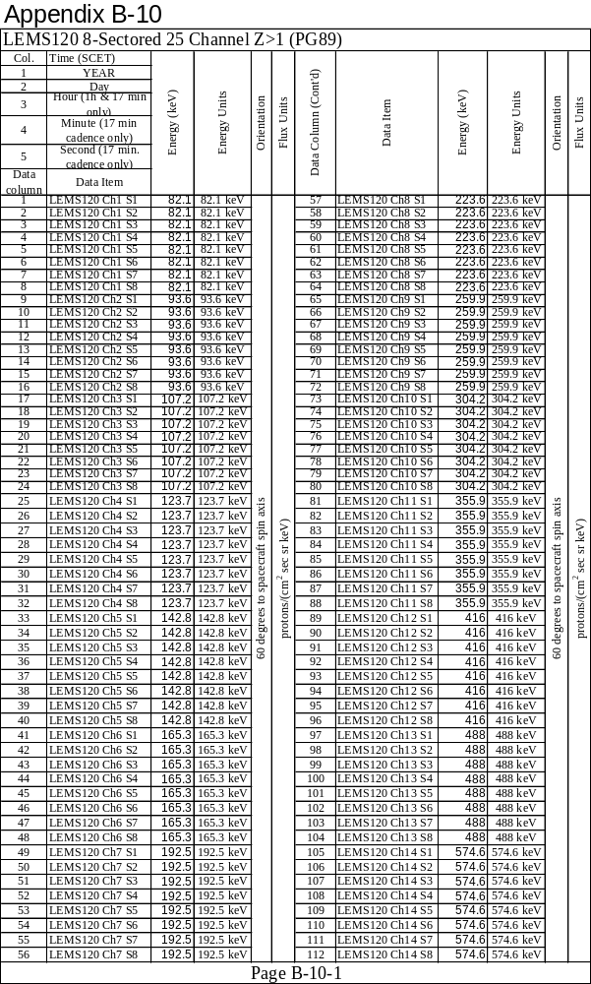

Slide 34
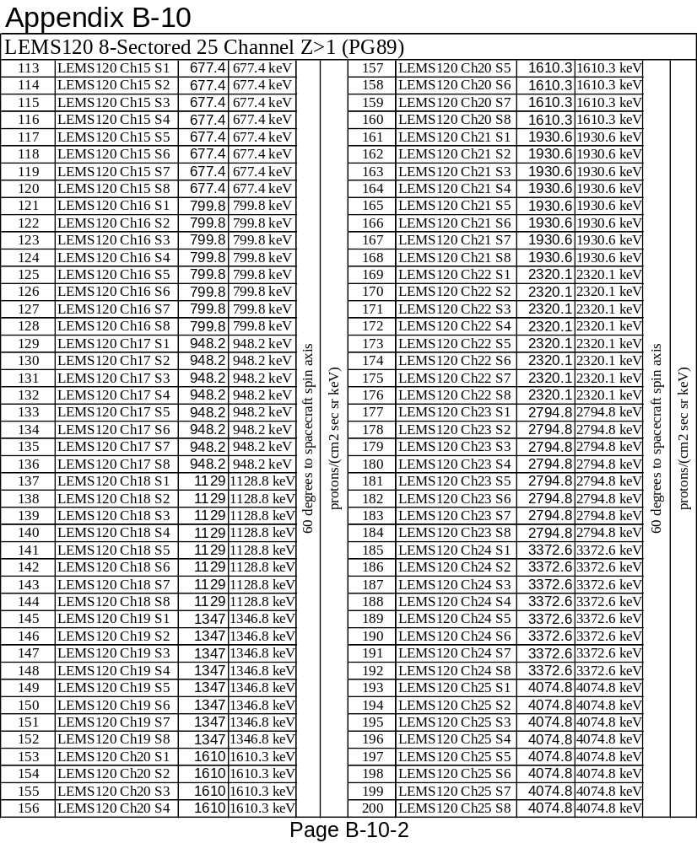

Slide 35
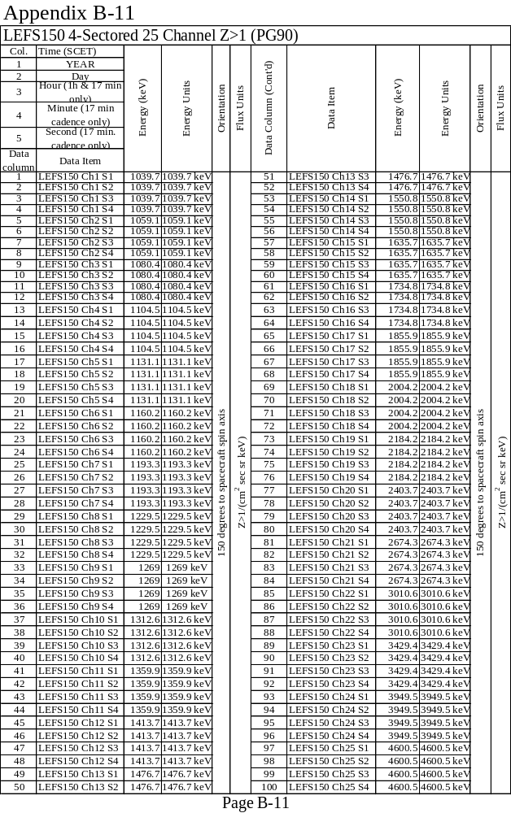

Slide 36
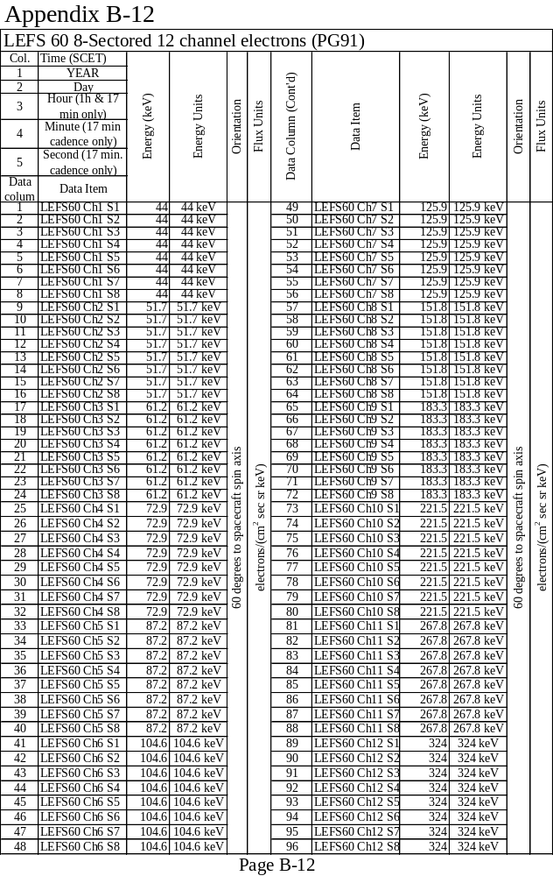

Slide 37
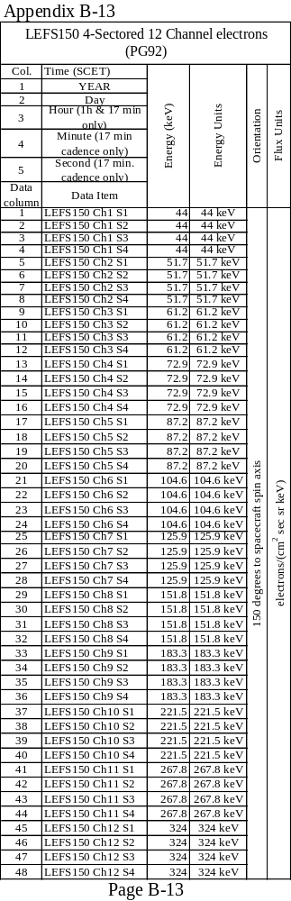

Slide 38
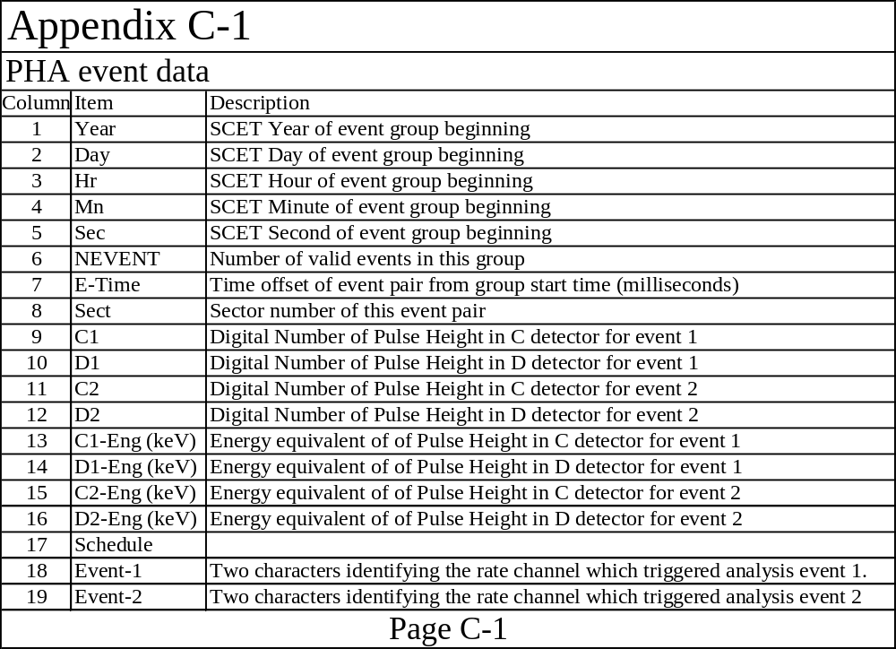

Slide 39
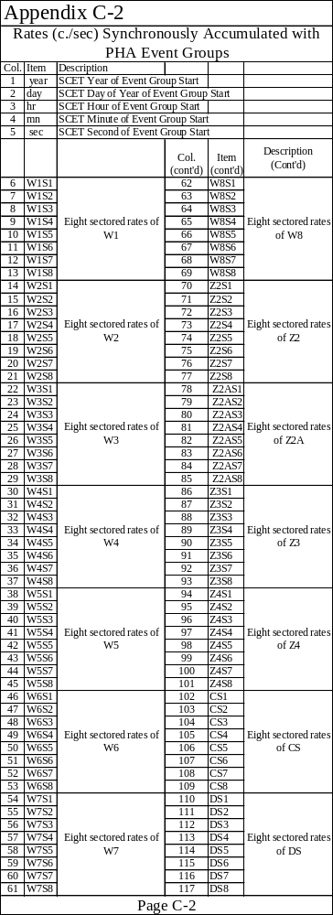

Slide 40
The End
(A really big ending)

